Slide 1

Aviation Risk Analysis for Strategic Aircraft Acquisition

Slide 2

AGENDA
Executive Summary
Objective: Identify low-risk aircraft models based on historical accident data.
Data Source: NTSB aviation accident data (1990–2023).
Key Deliverables:
Trends in aviation accidents.
Aircraft models with lower fatality and severe damage rates.
Strategic recommendations for fleet acquisition.

Slide 3

Business Objective
Support the company's entry into aviation through data-driven fleet selection.
Minimize operational and insurance risks.
Invest in aircraft models with historically safer profiles.
Approach & Data Overview
Dataset: 70,000+ records from NTSB covering 1962–2023.
Filtered Scope:
Accidents (not incidents).
Events from 1985onward.
Excluded amateur-built aircraft.
Methods:
Data cleaning and standardization.
Risk metric calculation:
Fatal accident rate.
Severe damage rate.

Slide 4

Key Metrics Defined
Fatal Accident Rate (%):
Percentage of accidents that resulted in fatalities for a given aircraft model.
Severe Damage Rate (%):
Percentage of accidents where the aircraft sustained substantial or destroyed damage.
Combined Risk Profile:
Aircraft evaluated on both metrics for balanced safety assessment.

Slide 5

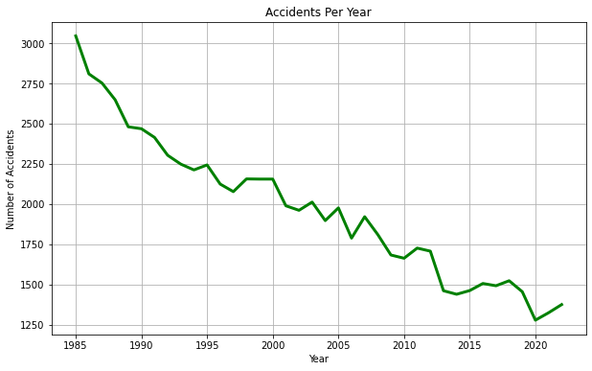
Aviation Accident Trends (1990–2023) Gradual decline in accidents from 1990 to mid-2010s. Accident rate stabilizing in recent years.

Slide 6
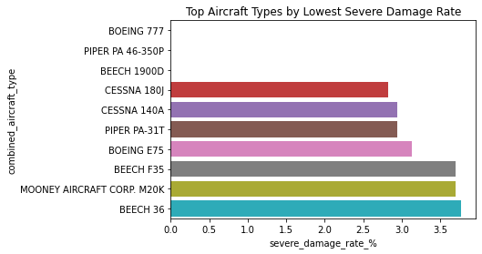
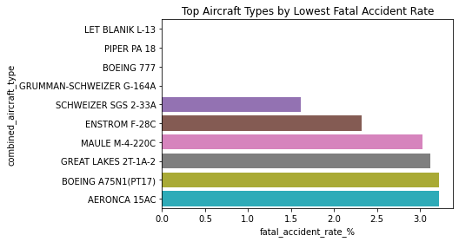
Risk by Aircraft Models
Certain Models Consistently Demonstrated Lower Fatality And Severe Damage Rates.
Models With 25+ Recorded Accidents Analyzed For Reliability.
Examples of Low-Risk Aircraft:
Cessna 172S
Piper PA-28-161
Beechcraft G36 Bonanza

Slide 7
Risk Comparison: Fatality vs Severe Damage
Strong variation in risk profiles between models.
Some aircraft are low in both fatal and severe damage rates.
(Insert Scatter Plot: Fatal Accident Rate vs Severe Damage Rate)
Key Insight:
Not all commonly flown aircraft are equally safe.
Key Findings
Accident trends: Decreasing then stabilizing post-2010.
Model risk variation: Wide differences even within popular makes.
Low-risk candidates identified: Certain Cessna, Piper, and Beechcraft models outperform peers.
Limitation: No normalization for flight exposure (flight hours).

Slide 8
Strategic Recommendations
Prioritize Due Diligence on Low-Risk Models:
Cessna 172S
Piper PA-28-161
Beechcraft G36 Bonanza
Exercise Caution:
Conduct deeper review of models with high fatal or damage rates.
Incorporate Flight Hour Data:
Normalize risk scores if possible before final fleet selection.

Slide 9

THANK YOU
Samwel Ongechi
samwel.ongechi@student.moringaschool.com

